Slide 1
Chapter 5: Compiling C++ to Assembly Language

Slide 2
Compilers
Translates a high-level program into a lower level program.
Some into machine language
Others into assembly language or some intermediate code.
Then need an assembler.
Input: source program
Output: object program (regardless of what language)

Slide 3
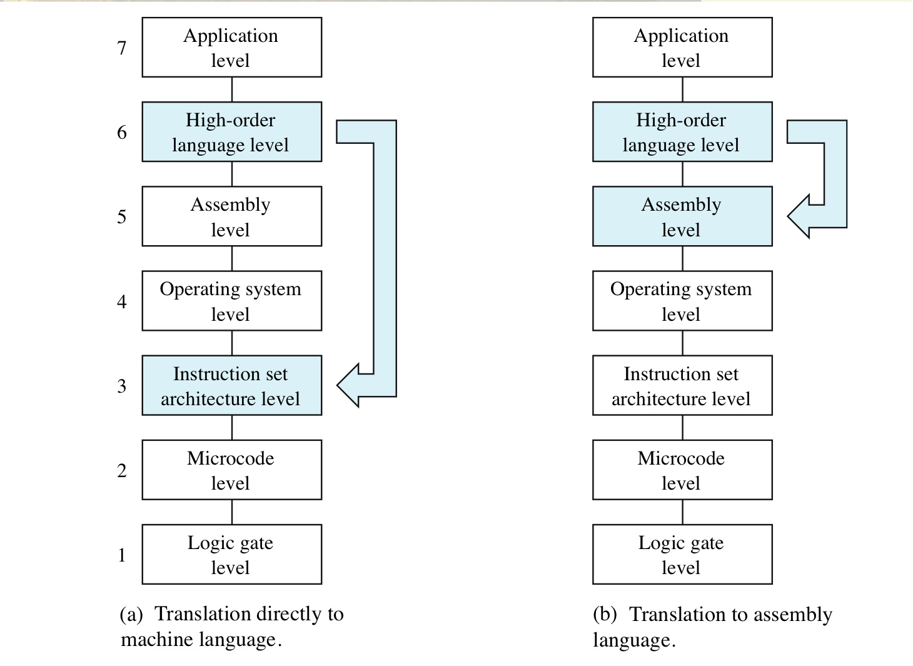
The function of a compiler

Slide 4
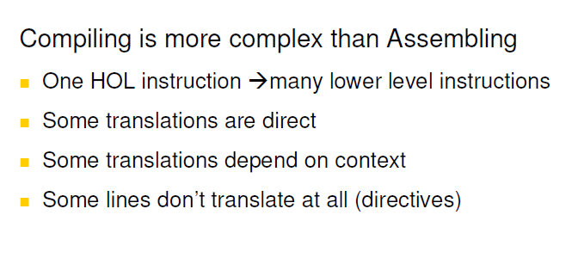
Compilers

Slide 5
Compilers
Example: next slide
1 C++ statement to 4 assembly statements
Compilers do 1-to-many mappings
Include is not translated; pre-compiler would include the code or link to appropriate library code
Other translations of cout are possible.
Different compilers generate different machine programs.
All are correct
Some are more efficient.

Slide 6
Compilers
Example: next slide
Return 0 is translated as "stop".
Real compiler would translate as return to OS
Return value will be stored in a register and interpreted by the OS
Traditionally return value of '0' means no errors
In functions other than main, would return from function instead.

Slide 7
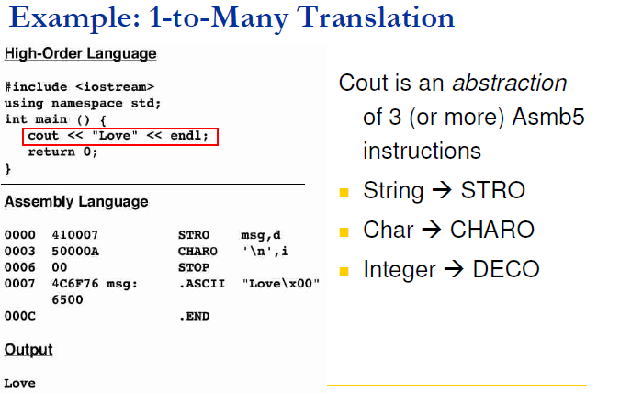
The cout statement at Level HOL6 and Level Asmb5

Slide 8
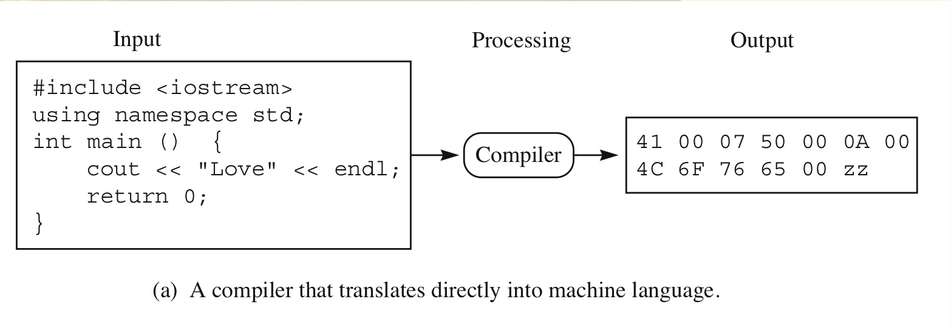
A compiler that translates directly into machine language
#include <iostream>
Using namespace std;
int main( ){
cout<< "Love“ << endl;
return 0;
}

Slide 9
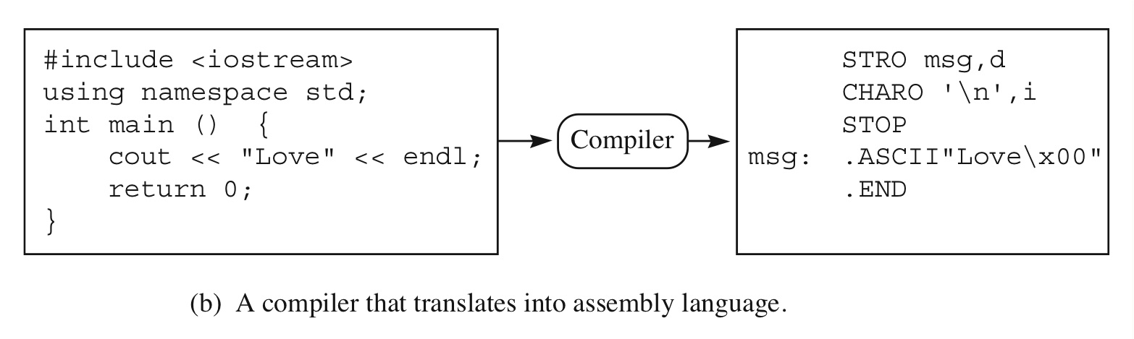
A compiler that translates into assembly language
#include <iostream>
Using namespace std;
int main( ){
cout << “love” << endl;
return 0;
}

Slide 10
Variables and Types
Every C++ variable has 3 attributes:
Name
Type
Value
Variables correspond to memory locations
Level 6: refer to variables by names
Level 3: refer to variables by addresses

Slide 11
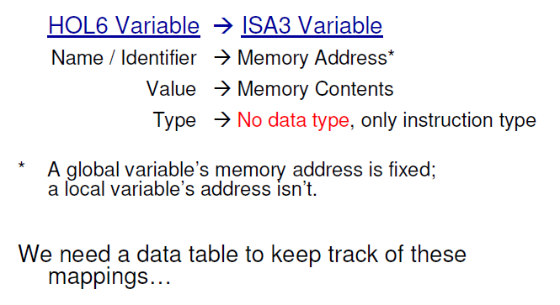
Variables and Types

Slide 12
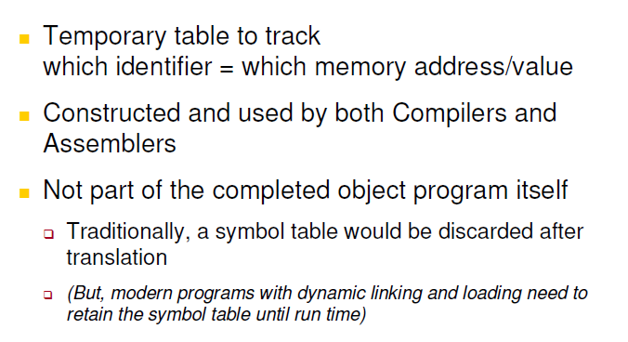
Variables and Types
Compiler translates variables to addresses
Uses symbol table
Similar to symbol table of assembler, but more complicated
Must also contain type

Slide 13
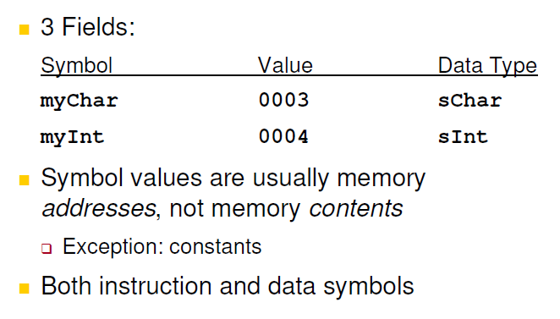
Symbol Table Contents

Slide 14
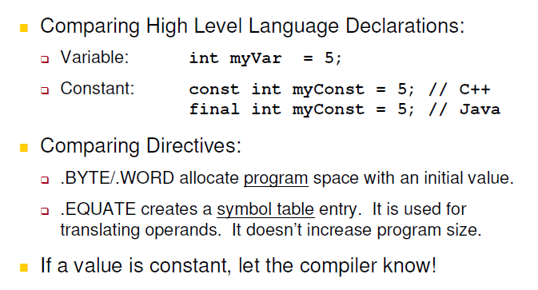
Variables Vs. Constants

Slide 15
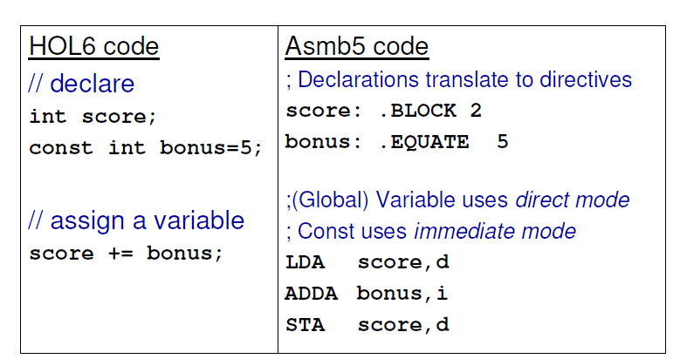
Compiling Global Variable and Constants

Slide 16
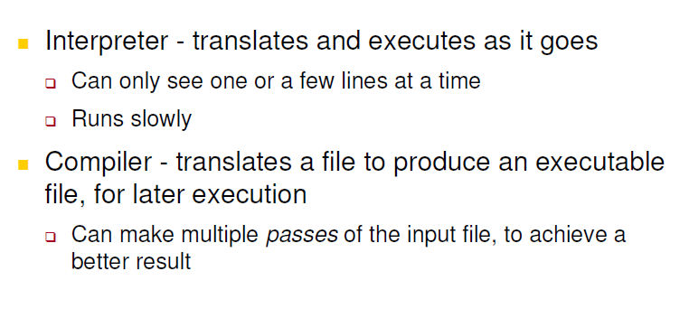
Compilers Vs Interpreters

Slide 17
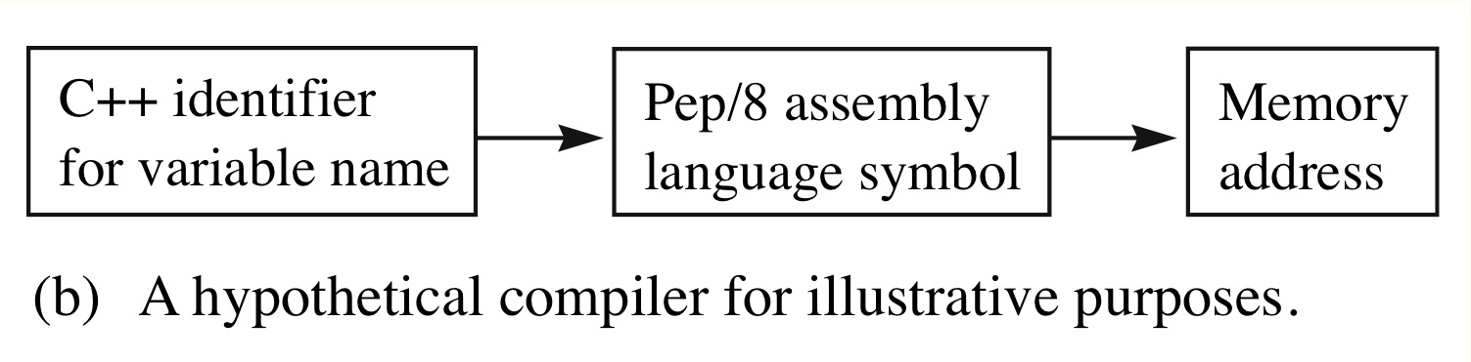
A hypothetical compiler for illustrative purposes
We will show translation from C/C++ to
Assembly for illustrative purposes.
Variable names will correspond to Pep/8
Symbols. Really would be addresses.

Slide 18
Assignment Statements
Global variables:
Allocated at a fixed location with a .block
Accessed with direct addressing (d)
Assignment statements
Load accumulator from the right hand side of the assignment with a LDA
Compute the RHS of the assignment if necessary.
Store the value to the variable named in the LHS with a STA

Slide 19
Assignment Statements
Example:
i +=5;
Becomes
LDA i,d
ADDA 5,i
STA i,d

Slide 20
Assignment Statements
Example:
ch++;
Becomes
LDBYTEA ch,d
ADDA 1,i
STBYTEA ch,d

Slide 21
The assignment statement at Level HOL6 and Level Asmb5
#include <iostream>
using namespace std;
char ch;
int i;
main(){
cin >> ch >>i;
i+=5;
ch++;
cout << ch << endl << i << endl;
return 0;
}

Slide 22
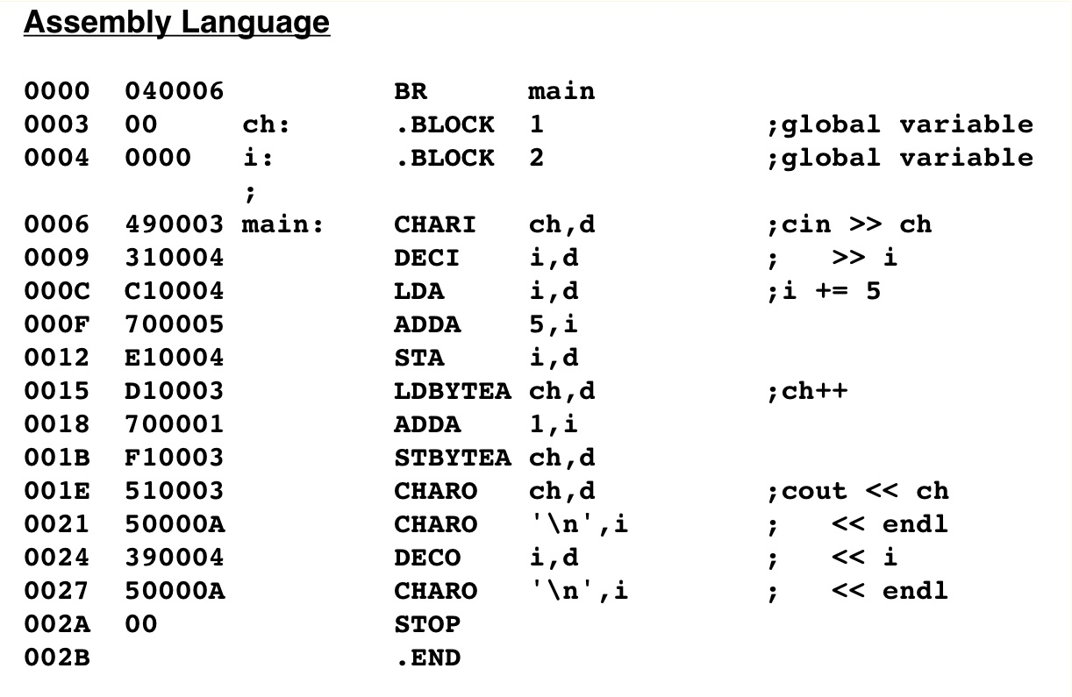
The assignment statement at Level HOL6 and Level Asmb5
Why one byte?
Why load a byte?

Slide 23
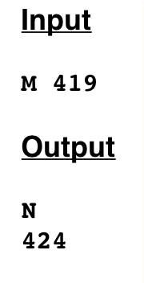
The assignment statement at Level HOL6 and Level Asmb5

Slide 24
Compilers
Compilers are just programs
Can be written in any language
Need symbol tables. See next slide.
An entry contains 3 parts: the symbol, its value (address) and the type.

Slide 25
Type Compatibility
Example: two variables in a C++ program
Note that Pep/8 cannot represent float variables
int j;
float y;
Symbol table is on next slide.

Slide 26
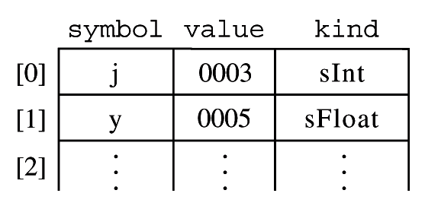
The symbol table for a Pep/99 compiler

Slide 27
Symbol tables and compilers
During code generation phase, the compiler translates:
cin << ch << i;
Into
CHARI 0x003, d
DECI 0x004, d
Based on the values in the symbol table
Listings in these slides will show symbolic names to enhance understandability.

Slide 28
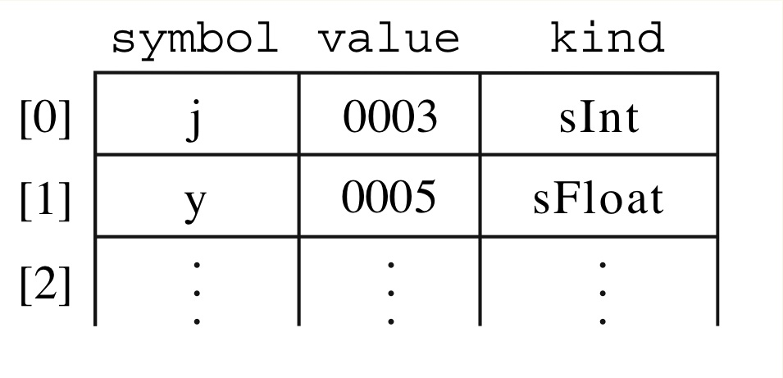
Type Compatibility
Consider a C++ program that declares two variables: int j; float y;
Will get symbol table entries:

Slide 29
Type Compatibility
Consider
j % 8
In binary set all bits except rightmost 3 to 0
Example:
If j has value 59 (dec) = 0011 1011 (bin)
Then j % 8 is 3 (dec) = 0000 0011 (bin)
Same as value 59 with all but last 3 bits set to 0

Slide 30
Type Compatibility
Consider
j % 8
When compiler sees this expression it consults the symbol table and determines the type of j is sInt.
Also recognizes 8 as integer constant
So % operation is legal.

Slide 31
Type Compatibility
Compiler generates the code
LOADA j,d
ANDA 0x0003,i
STOREA j,d

Slide 32
Type Compatibility
Now consider: y = y % 8
Compiler consults the symbol table and determines that the type of y is sFloat.
Then determines that % is not legal on a sFloat type.
Generates an error (real compiler would generate code to change y to integer).

Slide 33
Type Compatibility
Now consider: y = y % 8
If did not check type, compiler would generate code:
LOADA y,d
ANDA 0x0003,i
STOREA y,d
Which does not work because floats are stored in special format.

Slide 34
Type Compatibility
Note that the compiler catches type errors at compile time, not run time.
Assembly/machine code does not check type.
So there can be no run time check of type.

Slide 35
Shift and rotate
Pep/8 has
two arithmetic shift instructions
Two logical shift instructions
0001 110r ASLr Arithmetic shift left r NZVC
0001 111r ASRr Arithmetic shift right r NZC
0010 000r ROLr Rotate left r C
0010 001r RORr Rotate right r C

Slide 36
Shift and Rotate
No operand specifier in these instructions
Only work on specified register
Effect:
Shift left multiplies by 2
Shift right divides (integer) by 2
Rotate left rotates each bit to the left one bit, sending the most significant bit into C and C into the least signficant bit.
Rotate right rotates each bit to the right one bit, sending the most least bit into C and C into the most signficant bit.

Slide 37
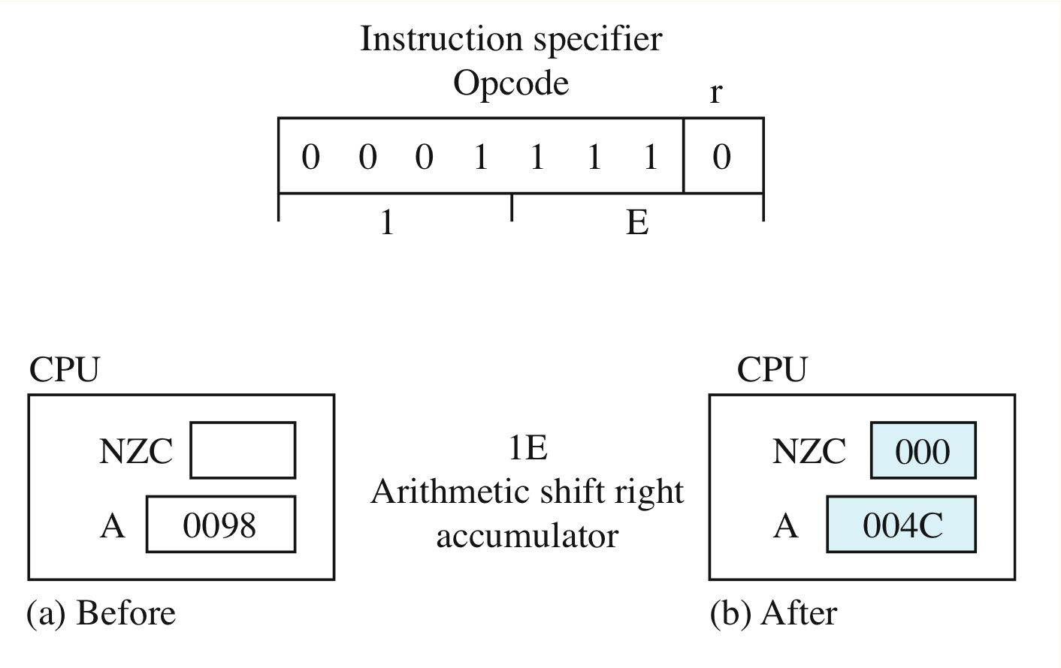
Shift and Rotate
Example:

Slide 38
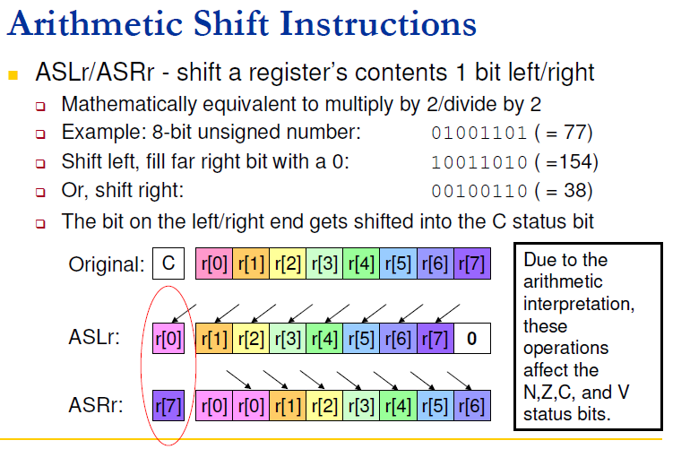
Shift and Rotate

Slide 39
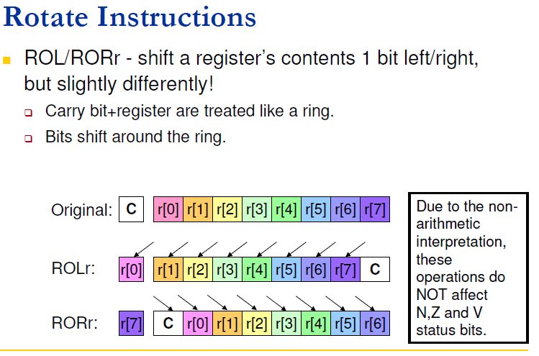
Shift and Rotate

Slide 40
Constants
Create constants with the .EQUATE command.
Creates an entry in the symbol table
Does not create bits in the machine code
Operation:
It must be on a line that defines a symbol
It equates the value of the symbol to the value that follows the .EQUATE
It does not generate any object code

Slide 41
Constants
Example:
linefeed: .EQUATE 0x000A
Everywhere in program that the symbol linefeed occurs, assembler replaces with 0x000A
Similar to C++ code:
const int lineFeed = 10;
Or the preprocessor command:
#define lineFeed 10

